Slide 1
The Business of Trading the Financial Markets
Anatomy of a Trading Plan
Written by
Neil Wrightson
Email - trading@nwe.net.au
© Copyright Neil Wrightson January 2008
Notes:
Good morning all
Thank you Brian
I will try to make this as good as Lee’s talk on Gann swing charts.
But Lee has set the bar rather high.
This presentation came about because of a subject that Shirley brought up in a previous ATAA meeting.
Basically Shirley asked. What is your trading plan?
Everybody responded with their own version i.e. MA cross etc.
But to me, my interpretation of Shirley’s question was different to everybody else’s.
Because what I was hearing was their trading strategies not their trading plan.

Slide 2

Forward
This presentation is a combination of my own personal ideas and beliefs as well as a compilation of ideas from books, journals and guest speakers at the ATAA.
A specific trading plan must be tailored to suit each individual. This allows them to apply their own unique thumb print to the plan.
Notes:
Thank family for assistance and feedback
As one exercise plan will not suite all people, due to
the various factors such as gender, size, body
composition etc.

Slide 3
The primary component of financial success in the markets is –
”A Business Trading Plan”
Notes:
TO ME

Slide 4
Overview
The ultimate goal of trading is to make money.
No different to any other business.
In order for a business to be successful, we must have a business plan. Without a business plan that is well designed, structured and written down, no bank (or wife) will ever lend you money to start up the business.
So why should we treat financial trading of the
markets any different.

Slide 5
Why use a Trading Plan
A trading plan defines the reasons, rules, rewards and targets for conducting the business.
Without a plan in place, we are apt to wander aimlessly through the markets, making donations (losses) from one money game to the next.
The act of creating, writing down and prominently displaying our trading plan, helps prevent us deviating from our intended methodology and keeps us guided towards profits.
Notes:
I know, I have been there, as I’m sure most people have.
It is all a part of the learning process.
Writing it Down
Physically writing it down, tends to imbed the plan more firmly into our sub conscious and helps prevent us from deviating from the plan.
Prominently Displayed

Slide 6
Components of a Trading Plan
Part 1
→ Reason for Trading
→ What markets to trade
→ Money Management & Allocation
→ Trading Strategies
→ Rules for when we are losing
→ Rules for when we are winning
Notes:
After this slide, I have the theory of each these points as a separate slide then followed by an example slide.
Examples
These examples are intended as a guide only.
They are not part of my personal trading plan
And are completely fictitious.
So only use as a guide to what should be in this area.
As in the third slide, each individual should have their own trading plan.

Slide 7
Components of a Trading Plan
Part 2
→ Evaluation
→ Daily & Weekly Tasks
→ Goals & Rewards
→ Education
→ Emergency contingencies
Notes:
After this slide, I have the theory of each these points as a separate slide then followed by an example slide.
Examples
These examples are intended as a guide only.
They are not part of my personal trading plan
And are completely fictitious.
So only use as a guide to what should be in this area.
As in the third slide, each individual should have their own trading plan.

Slide 8
Components of a Trading Plan
Part 1

Slide 9
Reason for Trading
Defining this helps us understand what we aim to achieve out of this business.
Examples :
Is trading purely a social event?
An adjunct to our existing 9 to 5 job?
An addition towards our retirement fund?
Will this be our sole source of income?
Financial independence
Freedom – Trade from anywhere
Your own boss
Mental challenge & stimulation

Slide 10
Reason for Trading - Example
Secondary income after workplace accident & insurance payout.
Only able to sit for short periods of time due to injury.
Ideal strategy would involve trades of that are of a 1..10 day duration.
Overseeing the trades during the morning and afternoon sessions

Slide 11
What Markets to trade
Shares
CFDs
Options
Bonds
Futures
Forex
Etc
It is not only the market type but also the time period that needs to be decided on.
This decision should also be reflected in the “Reason for Trading” area of our plan.

Slide 12
What Markets to trade - Example
I plan on trading the following instruments –
CFDs on the top ASX 100 shares.
This is due to CFDs being able to be traded long as well as short and the additional buyer power (leverage).
I must exercise care in trading CFDs due to this leverage and ensure that my stops are adequately set to reflect the true value of the position.
For CFD trading I will be using a short period (3..8 day) trading strategy. This will be in line with “Oliver Velez” style of trading.
Futures – SPI
I will use the SPI for intra day trading. For this I will be using a squeeze play strategy.
Notes:
Remember – these are example only.

Slide 13
Money Management
In this area we define our money parameters for our overall plan and specific strategies.
We should nominate how much money we will allocate to each strategy and what the rules will be for with drawing of profits.
Trading Account composition
Maximum Risk per strategy
Position Size
Profit Goals
Profit Retention
Rules for when we are Losing
Rules for when we are Winning

Slide 14
Money Management
Trading Account composition and Maximum Risk per strategy - Example
I will use a $50,000 trading account.
This will be broken up into two areas as per my trading strategies.
CFD Trading - $30,000.00
SPI Futures Trading - $20,000.00

Slide 15
Money Management
Trading Account composition and Maximum Risk per strategy - Example
CFD Trading
For CFD trading I will create a separate trading account that will have $30,000 allocated to this account.
The maximum number of CFD positions I will hold at any one time is 10. This helps me to mentally track and manage these trades. The maximum that I will risk at any one time will be 1% per position with a maximum of 5% for the whole account.

Slide 16
Money Management
Trading Account composition and Maximum Risk per strategy - Example
SPI Futures Trading
For this strategy I will only be trading 1 contract at a time.
The margin is $8000 per contract, hence the reason for allocating $20,000 to this strategy.
The maximum to be risked on any one trade is 10 points or $250.00

Slide 17
Money Management
Profit Goals - Example
SPI Futures
Income goal is $50,000 per year, full time trading.
$50,000 / 12 = $4170 per month
$4,170 / 4 = $1050 per week
$1,050 / 5 = $210 per day
This equates to 10 points per day.

Slide 18
Trading Strategies
Trading Strategies must be clearly defined and contain the following :
  Market
  Maximum Position Size
  Risk to Reward Ratio
  Expected return per trade
  Initial Stop criteria
  Entry criteria
  Exit criteria
  When to trade
  Emergency contingencies
  Example chart
  Example Log

Slide 19
Trading Strategies - Example
Strategy Name – The ANTI. (Linda Bradford Raschke)
  Market = CFDs on the ASX100
  Maximum Risk per trade = 1% of Capital = $300 = $3000 CFD
  Maximum Position Size = 10% of Capital = $3000 = $30000 CFD
  Risk to Reward Ratio = 2.5:1
  Expected return per trade = $290
  Initial Stop criteria = Below the Bar of Entry
  Long Entry criteria = This trade is based on the Stochastic
  Indicator.
  It looks for a turn up of the %K after a momentary dip.
  Long Exit criteria = Usually 3..5 bars or break below 5SMA
  or 8SMA depending on the strength of
  the trend.
  When to trade = 10:00AM to 4:00PM – Full AUS Trading
  Emergency contingency's = Gap Exit Strategy
Notes:
They must contain the following components –

Slide 20
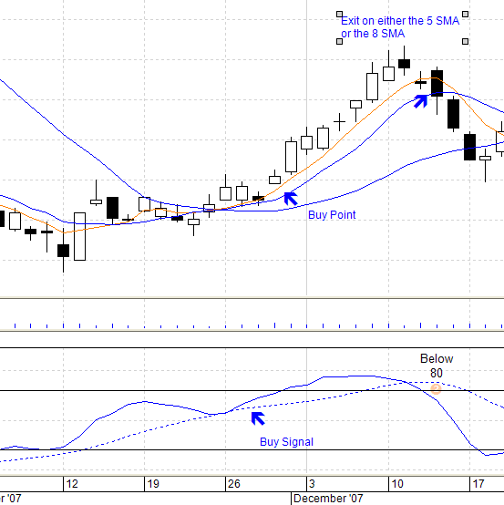
Trading Strategies – Example
Strategy Name – The ANTI. Sample Chart showing trade
Notes:
They must contain the following components –

Slide 21
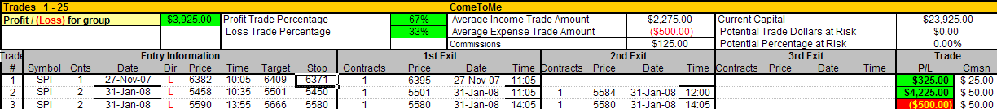
Trading Strategies – Example
Strategy Name – The ANTI. Sample log of trades
Notes:
They must contain the following components –

Slide 22

Money Management -
Rules for when we are losing
In this area we define what our draw down rules will be.
This not only protects are account but also psychologically protects us during periods of draw down.
The psychological aspect is as important as the financial aspect.
Questions to be answered are -
What is my daily maximum draw down?
What are my weekly drawdown rules?
What are my monthly drawdown rules?

Slide 23
Money Management
Rules for when we are losing - Example
My daily maximum draw down is 2% of the account
If this is reached, then I stop trading for the rest of the day.
My weekly maximum drawdown is 5% of the account.
If this is reached, then I stop trading for the week.
My monthly maximum drawdown is 15% of the account.
If this is reached then I stopped trading completely and re-evaluate my trading plan and strategies.
Until I have found the fault/faults with either my strategies or trading plan, all trading remains stopped.

Slide 24
Money Management
Rules for when we are winning
Winning => Euphoria => Reckless trading
So for this reason, lots of the professionals in the markets will tell you that it is a good idea to leave some on the plate.
“Be grateful for what you have, for it is easily lost.”
Rules for Winning:
Daily Profit Target
Weekly profit Target
Monthly profit Target
Yearly profit Target
Notes:
It might sound ridiculous to place rules against winning too much money.
So as in “Rules for when we are Losing”, we should also have the following
Winning Can lead to

Slide 25
Money Management
Rules for when we are winning - Example
If I reach my 2 * Daily Profit target and the next trade is a loss, then I quit for the day.
If I reach 2 * my Weekly Profit target before the end of the week, then I take the rest of the week off.
If I reach 3 * my Monthly Profit target before the end of the month, then I take the rest of the month off.
If I reach 2 * my Yearly target with a quarter of the year remaining, then I take the rest of the year off.
Notes:
28th January - Biggest Roage trader scandle
Société Générale Bank (Soc Gen)
50 Billion position size closed out at 7.2 billion loss.

Slide 26
Traders are blocking the SG building parking area, protesting against the fact that they will not receive their bonuses this year
Notes:
Société Générale Bank (Soc Gen)
50 Billion position size closed out at 7billion loss.
Biggest Roage trader scandle
Low-tech hack was behind $7.2bn SocGen fraud
FSA warns City on risks
By John Leyden → More by this author
Published Wednesday 30th January 2008 13:39 GMT
Find out how your peers are dealing with Virtualization
The French software developer turned rogue trader who cost French bank Société Générale an estimated €4.9bn ($7.2bn) used co-workers' access codes to set up fraudulent transactions.
Jerome Kerviel used his colleagues' access codes and sent fraudulent email in order to create fictitious accounts to take risky positions in the derivatives market, resulting in huge losses as stock markets across Europe fell. He used his five years' experience in helping to develop the bank's trading systems to remove limits on his personal trading positions, and faked customer accounts to balance the books.
He also used hacking techniques to turn off warning systems that could have alerted his bank about anomalous trading patterns, The Daily Telegraph reports. This sounds complicated, but could have been as simple as manipulating the production of Excel spreadsheets that are used to provide trading updates to bosses, according to City experts.

Slide 27
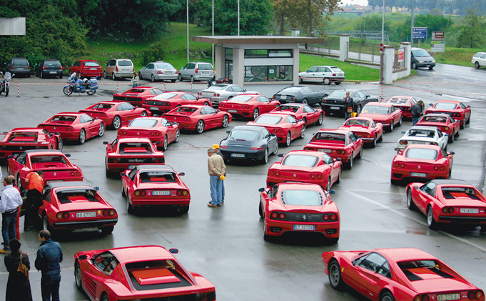
Notes:
Societe General Bank (Soc Gen)
50 Billion position size closed out at 7billion loss.
Biggest Roage trader scandle

Slide 28
Anatomy of a Trading Plan
End of Part 1

Slide 29
Anatomy of a Trading Plan
Components of a Trading Plan
Part 2

Slide 30
Evaluation
Individual Trades
It is important to make a hard printed copy of each trade and document the key points about this trade. Each trade should also have two scores awarded.
  The first for the success/failure of the strategy
  The second for the success/failure of the trader

Slide 31
Evaluation
Overall Strategy evaluation
It is important to generate an overall strategy profit report. This should have a predefined means of displaying when the strategy is profitable and when it should be placed on hold.
Overall Trader Evaluation
It is important to monitor your own performance. This is a reflection on how well you are performing as a trader. A profitable strategy can be turned into a losing strategy by a trader that does not follow the rules.

Slide 32
Evaluation
Point Score Rules - All Trades will be rated as follows
Overall Strategy Evaluation
Target Hit. (Perfect)
Out at a different price, but profitable.
Out at Breakeven.
Out at a different price from stop but a losing trade.
Stop Hit.
Overall Trader Evaluation
Followed trade as dictated in the plan. (Perfect)
Followed trade entry but closed out position before predetermined target was hit.
Followed trade entry but removed stop and let position run past original target.
Entered setup late and didn’t set target.
Impulse trade.

Slide 33
Daily & Weekly Tasks
Daily Tasks
Prior to Market Open
Post Market Open
Manage Open positions
Pre Market Close
Post Market Close
Trade Recording
Strategy Record
It is important to make a hard printed copy of each trade and document the key points about this trade. Each trade should also have two scores awarded.
The first for the success/loss of the strategy
The second for the success/loss of the trader.
Financial Record
Every trade should be recorded in a journal. This could be a spreadsheet or alternatively in a journal book.
This should also clearly show any brokerage charges as a separate cost for taxation purposes.

Slide 34
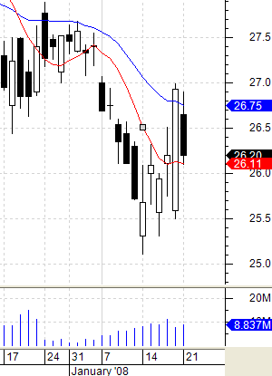
Daily Tasks - Example
07/01/2008
Instrument – ANZ
Strategy - Squeeze Play
Direction - Short
Entry Price - $27.00
Exit Price - $25.60
Qty - 1000
Profit - $1400.00
Strategy Score = 2
Personal Score = 2
Comments
Exited the trade to early.
Did not wait for the 8SMA.
This was due to the short being overdone.

Slide 35
Daily & Weekly Tasks
Weekly Tasks
Update Score charts with the weeks trades.
Evaluate as to whether the strategy is performing as expected. If not performing, put the strategy into emulation mode for further evaluation.
Evaluate Average Personal Score.
If possible balance your journal with an accountant statement. Including brokerage and other charges.

Slide 36
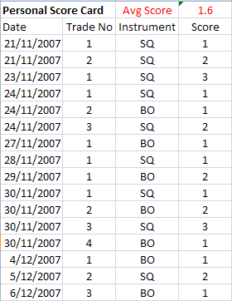
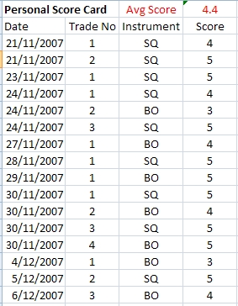
Weekly Tasks - Example
Personal Score Card Evaluation.
If the 5 Period average of the personal Score Card, crosses below 2.5 then stop trading.
A value below 2.5 on the Personal Score Card, indicates that we aren’t following our rules to the letter.

Slide 37
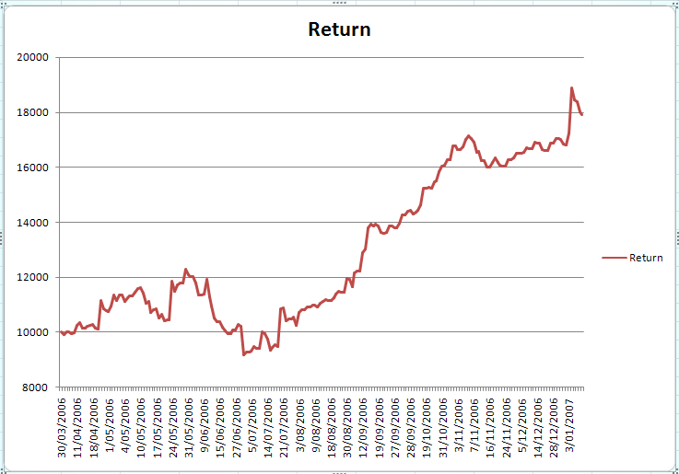
Weekly Tasks - Example
Results of the
MA Cross Strategy
MA Cross Strategy Evaluation

Slide 38
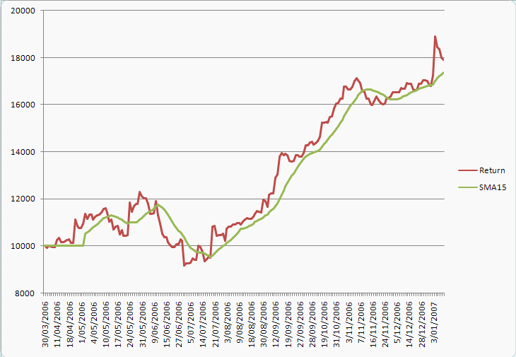
Weekly Tasks - Example
Strategy Stop
If the return on the “MA Cross” Strategy falls below the 15 period SMA, then STOP physically trading the strategy and put into paper trading mode.
MA Cross Strategy Evaluation

Slide 39
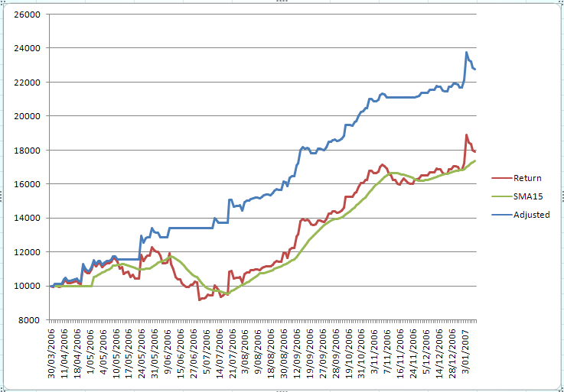
Weekly Tasks - Example
Strategy Stop
Results of the same strategy but using a 15 period SMA as a trading strategy stop.
Note how it stopped the large drawdown's.
In this case, it returned an additional 50% profit.
MA Cross Strategy Evaluation

Slide 40
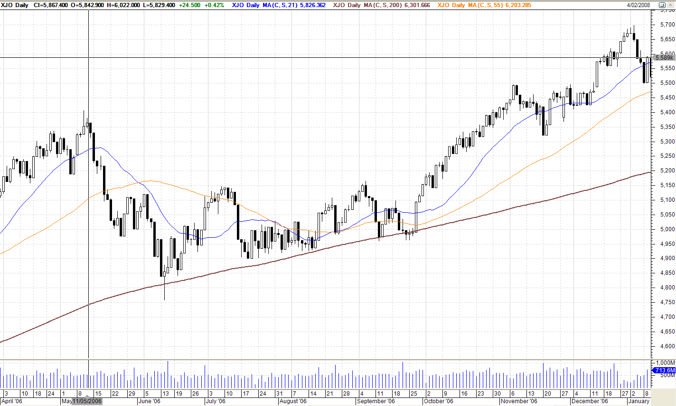
Weekly Tasks – Example
The previous strategy results were based on a system trading CFDs on the Top 100 stocks. Below is the XJO for the same period.

Slide 41
Goals & Rewards
Goals –
Are an important part of a plan. Without goals we have no means to measure whether we are succeeding or not.
As with any business it is important to establish realistic goals.
For each individual strategy, try to pick realistic goals for the day and goals for the week.
If we set our goals too high to start with, we are bound to fail, purely because we become depressed with the fact that we are not succeeding. This then feeds on itself, we start to break our rules to try and climb up faster but fall even further.

Slide 42
Goals & Rewards
Rewards –
It is important to reward yourself for a job well done. This does not mean buying a BMW after your first week of profit, it means rewarding yourself in a small way that gives you an ego & moral boost.
We all thrive on praise. This is our own pat on the back for a job well done.
This is not only for when you make a profit but also for when you trade according to the strategy rules.

Slide 43
Education
Use this area to highlight education you wish to partake in this year.
Examples are –
Reminiscence of a Stock Operator by Jesse Livermore
– Read this every year
ATAA Conference
Van Tharpe Book
Trading Conference in Hawaii

Slide 44
Emergency contingencies
We must have a document (preferably pinned to the wall) that details all of our critical information.
For those that travel, a smaller version carried on our person i.e. wallet/purse.
This way when we are travelling we can still ring the broker and
close a trade.
This should contain :
Brokers Name
Brokers phone number
After hours brokers support desk
Your Account Name
Your Account numbers
Alternate internet access details
Your Mobile phone number
Your Secondary phone line number
Backup power - UPS

Slide 45
In finishing
There is an old cliché
“If you fail to plan, plan to fail”
Thank you,
Neil Wrightson.
Notes:
So at a previous ATAA meeting, when Shirley brought up the subject of a trading plan.
This past hour is what went through my head.
In finishing, I hope that I have not bored you to much and you may have even enjoyed my presentation.
That applies to life as well as to trading.

Slide 46
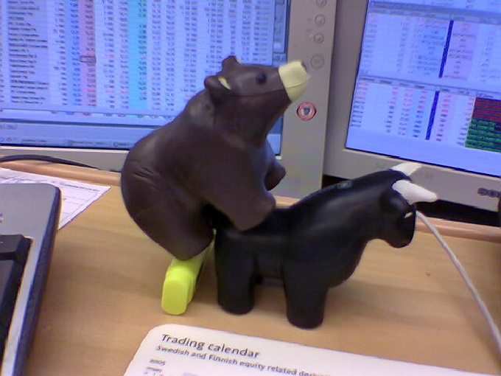
What the financial Markets Pro’s are up to!
Notes:
So at a previous ATAA meeting, when Shirley brought up the subject of a trading plan.
This past hour is what went through my head.
In finishing, I hope that I have not bored you to much and you may have even enjoyed my presentation.
That applies to life as well as to trading.

Slide 47
Bibliography & further reading
Trade your way to financial freedom
By VAN K. Tharp
Street Smarts
By Linda Bradford Raschke
Tools & Tactics for the Master Day Trader
By Oliver Velez
Mastering the trade
By John Carter
Notes:
So at a previous ATAA meeting, when Shirley brought up the subject of a trading plan.
This past hour is what basically went through my head.
In finishing, I hope that I have not bored you to much and you may have even enjoyed my presentation.

